Slide 1
Ironman Support Group
Steven Moody
June 2015
Notes:
This template can be used as a starter file for presenting training materials in a group setting.
Sections
Right-click on a slide to add sections. Sections can help to organize your slides or facilitate collaboration between multiple authors.
Notes
Use the Notes section for delivery notes or to provide additional details for the audience. View these notes in Presentation View during your presentation.
Keep in mind the font size (important for accessibility, visibility, videotaping, and online production)
Coordinated colors
Pay particular attention to the graphs, charts, and text boxes.
Consider that attendees will print in black and white or grayscale. Run a test print to make sure your colors work when printed in pure black and white and grayscale.
Graphics, tables, and graphs
Keep it simple: If possible, use consistent, non-distracting styles and colors.
Label all graphs and tables.

Slide 2
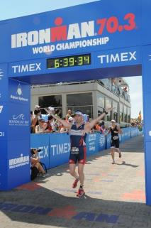
Welcome
& house rules

Slide 3
Who am I? (as if you don’t know – you saucy minxes but let’s play that game…)
Lead | Ironman Credentials
Steven | Current club Ironman record holder Ironman Barcelona 2014 finisher Challenge Roth 2014 finisher Ironman Frankfurt 2010 finisher Ironman 70.3 2010 Austria finisher Ironman 70.3 2012 Antwerp finisher Ironman 70.3 2012 World Championship finisher
Notes:
Keep it brief. Make your text as brief as possible to maintain a larger font size.

Slide 4
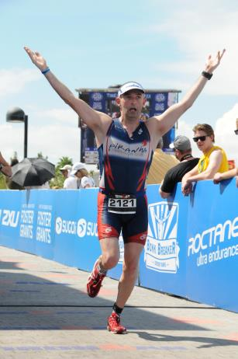
Learning Objectives
What you will get out of this session
An understanding of what is involved in “going long”
An understanding of what factors to consider in choosing the “best race” for you
A chance to ask questions/debate/input to club race preference
What you will not get out of this session
An overall training programme for your race
An explanation for your loved ones to explain why you no longer have time for them!
Notes:
What will the audience be able to do after this training is complete? Briefly describe each objective how the audience will benefit from this presentation.

Slide 5
Today’s Overview
1
2
What factors should I consider before signing up for an Ironman?
3
What training is typically involved?
What is Ironman all about?
Notes:
This is another option for an Overview slide.

Slide 6
Today’s Overview
4
5
Ok I have a race in mind – what next and by when?
6
Q&A
What Ironman would be best for me and/or the club?
Notes:
This is another option for an Overview slide.

Slide 7
What is Ironman all about?
The event was born from an argument in Hawaii over whether the fittest athletes were swimmers, cyclists or runners.
John Collins, a US Navy commander, and his wife (already experienced triathletes) combined the three existing long-distance competitions on the Island to settle the debate.
The first Ironman was staged in Waikiki, Honolulu on february 18, 1978, when 15 competitors took part. Twelve finished, with Gordan Haller, a US Navy communications specialist winning in 11:46:58 [THE RUNNER WON!!!!]
The Ironman series and the M dot logo is owned by World Triathlon Corporation (WTC) a for-profit corporation.
Ironman Europe split from WTC in 2001 and became challenge Roth, the Challenge series now rivals Ironman.
Roth is the worlds largest long distance triathlon with 5,000 athletes and 180,000 spectators expected in 2013.
Swim 2.4 miles! Bike 112 miles! Run 26.2 miles! Brag for the rest of your life!” - Commander Collins, USN (1978)

Slide 8
What factors should I consider before signing up for an Ironman?
Why go long? 2 types of athletes
bucket-list type – non competitive, plan on doing one Ironman and only one then moving on
Iron dreamer – competitive, wants to achieve the best Ironman performance he/she is capable of, even if it takes 10 tries
Common for all THE BRAGGING RIGHTS
Have you? Built a Base
Sprint, Olympic, 70.3
Knowledge, strength, experience
“I like to see people be able to ride for six hours and run for about two and a half hours,” Strauss says. “It doesn’t have to be fast”
As long as you’re healthy and can swim there’s nothing to it. Just train progressively until you are able to hit the relevant benchmarks – you’ve got 17hrs*
Continuous and steady paced, swim, bike run
Using the long open water swim race, century bike, marathon
Maintain effective training and race pacing
Heat rate, power, perceived effort
Age
Endurance improves from late 20’s – late 30’s
Stays constant until your really old – e.g. Moody
The Waiting game
Sometimes waiting is of not an advantage
Satisfaction
Set A, B, C, D, E, F goals for your first IM
Will you be happy with a E or F goal?
The X factors
Logistics, use of a prep race
Cost ← next few slides!
Family commitments
*16 hours in some cases
Notes:
This is just for those who have not signed up for an IM but are considering it.

Slide 9
How much might my Ironman journey cost me? - swim

Slide 10
How much might my Ironman journey cost me? - bike

Slide 11
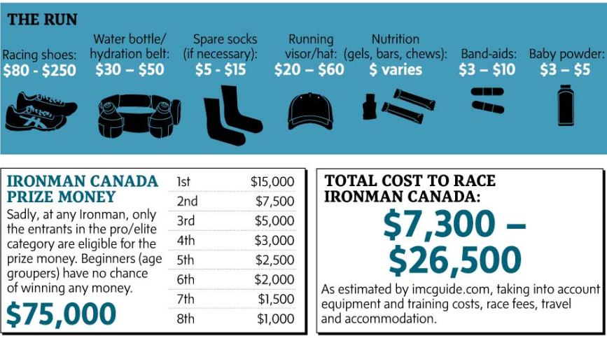
How much might my Ironman journey cost me? - run

Slide 12
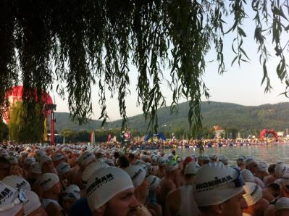
The infamous washing machine
This
Quickly Turns to
This

Slide 13
Find your bike

Slide 14
What training is typically involved?
Base, build & taper
Built into these 4week training blocks
Mini taper weeks every 4 weeks
Long 20/30 week plans allows for some easier weeks
Preparing for next block
Mini taper weeks to look forward to
3rd week of the block contain milestones e.g. longest distance SBR
Notes:
Just a principal that worked well for me with the 4-week blocks and mini tapers

Slide 15
Base training
What is it?
This is the time of year when you train to train, not train to race. That means in base you are preparing the body for the greater stresses that will follow in the build period © J. Friel 2008
Typically for an IM plan – this should be approx 3 – 4 months
Key success factors in your base plan will be the following
Flexibility
Consistency
Monitor able
Progression
Notes:
Summarize presentation content by restating the important points from the lessons.
What do you want the audience to remember when they leave your presentation?
Save your presentation to a video for easy distribution (To create a video, click the File tab, and then click Share. Under File Types, click Create a Video.)

Slide 16
Base training – what should I be doing?
Swim
2 – 3 sessions a week
Distance not massively important
Get technique right
Bike
1 long ride approx 4 – 5 hours NB Brick!!
2 – 3 short rides (hills/Turbo is very good method to get in the specific sessions esp in winter)
Run
1 long run a week
2 short runs a week (hills)
Other
Weight management - determine base level and a plan to achieve racing weight
Learn bike maintenance – courses available
Book accommodation (no cost if cancel)
Talk to others who have done your race and get their advice that may affect training (NB Ironman hall of fame)
Notes:
Summarize presentation content by restating the important points from the lessons.
What do you want the audience to remember when they leave your presentation?
Save your presentation to a video for easy distribution (To create a video, click the File tab, and then click Share. Under File Types, click Create a Video.)

Slide 17
Sample IM training plan (Base phase)
 | Mon | Tues | Weds | Thurs | Fri | Sat | Sun
AM | REST | Piranha swim | 60 min turbo | Swim session | Piranha swim | 2 hour bike & brick session | Long cycle 3 hrs +
PM | Core | Aerobic run session – 60 mins | Tempo run session – 10km | 75 min turbo | Aerobic run session – 60 mins | Core | Core

Slide 18
Build training
What is it?
This is the time of year you train to race.
Typically for an IM plan – this should be approx 1.5 months
Key success factors in your base plan will be the following
Increased race specific training (“b” races, transition practice, nutrition practice etc)
Increased speed element (tempo sessions – race specific pace sections of sessions)
Are you in line with target weight for this phase?
NB Plan still needs to element
Flexible
Consistency
Monitor able
Progression
Notes:
Summarize presentation content by restating the important points from the lessons.
What do you want the audience to remember when they leave your presentation?
Save your presentation to a video for easy distribution (To create a video, click the File tab, and then click Share. Under File Types, click Create a Video.)

Slide 19
Build training – what should I be doing?
Swim
Open water sessions
Long distance sessions – NB 3.8 km swim
Get technique right
Bike
1 long ride approx – race pace tempos
Train for the course – build in more hills etc
Run
Tempo run sessions
2 short runs a week (hills)
Other
Book flights/bikes [if made through training – much lower risk of DNS]
Notes:
Summarize presentation content by restating the important points from the lessons.
What do you want the audience to remember when they leave your presentation?
Save your presentation to a video for easy distribution (To create a video, click the File tab, and then click Share. Under File Types, click Create a Video.)

Slide 20
Sample IM training plan (Build phase)
 | Mon | Tues | Weds | Thurs | Fri | Sat | Sun
AM | REST | Piranha swim | Core | Piranha swim | Swim session | Bike 45 mins with 2km brick | Fingal sprint with 10 km cool down
PM | REST | Tempo run session – 15km | High cadence spin session(2 hrs) | Piranha track session (speed) | Core | REST

Slide 21
Training top tips
Build a training group – share knowledge
Get equipment right
Wetsuit research
Bike fitting
Runner selection
Use simple motivational tools
Soft targets
Weight watching
Injury prevention/management
Strength and conditioning
Rest! NB Sleep is crucial
Sports massage (recommended)
Listen to your body
Flexible training plan, e.g. drill set can be as effective as a long paced swim
Notes:
Summarize presentation content by restating the important points from the lessons.
What do you want the audience to remember when they leave your presentation?
Save your presentation to a video for easy distribution (To create a video, click the File tab, and then click Share. Under File Types, click Create a Video.)

Slide 22
Training top tips
Build a training group – share knowledge
Get equipment right
Wetsuit research
Bike fitting
Runner selection
Use simple motivational tools
Soft targets
Weight watching
Injury prevention/management
Strength and conditioning
Rest! NB Sleep is crucial
Sports massage (recommended)
Listen to your body
Flexible training plan, e.g. drill set can be as effective as a long paced swim
Notes:
Summarize presentation content by restating the important points from the lessons.
What do you want the audience to remember when they leave your presentation?
Save your presentation to a video for easy distribution (To create a video, click the File tab, and then click Share. Under File Types, click Create a Video.)

Slide 23
What Ironman would be best for me and/or the club?
What the course like?
Climate – hot/cold – non wetsuit swim?
Time of year? Does it fit with other objectives?
What logistics are involved? – single vs split transition? Rental car required?
Time to prepare? Where are you now?
Other commitments?
Buy in from family/partners/pets?
Notes:
Summarize presentation content by restating the important points from the lessons.
What do you want the audience to remember when they leave your presentation?
Save your presentation to a video for easy distribution (To create a video, click the File tab, and then click Share. Under File Types, click Create a Video.)

Slide 24
Analysis of top 3 survey results
 | Austria - 29% - 8 votes | Barcelona - 26% – 7 votes | Mallorca 15% – 4 votes
Course – swim | Lake - Avg temp : 22 °c (2012 non wetsuit swim) | Ocean Avg temp: 22 °c | Ocean Avg temp: 21 °c (2014 non wetsuit swim)
Course – bike | Demanding – 1600m | Easy – 500 m | Tough - 2200
Course - run | Demanding – 4 laps | Medium – 4 laps | Easy – 4 lap
Climate | Avg temp: 29°c - warm | Avg temp: 22°c - cool | Avg temp: 24°c - warm
Logistics | Split transition | Single transition Hotels beside finish line | Split transition
Time of year | June race i.e. Base Jan – March Build April - May | Oct race i.e. Base May - July Build Aug - Sept | Sept race i.e. Base April - June Build July – Aug
SMTB | Y | Y | Y
Notes:
Summarize presentation content by restating the important points from the lessons.
What do you want the audience to remember when they leave your presentation?
Save your presentation to a video for easy distribution (To create a video, click the File tab, and then click Share. Under File Types, click Create a Video.)

Slide 25
Analysis of other options
 | Sweden - 7% - 2 votes | Copenhagen - 7% - 2 votes
Course – swim | Ocean Avg temp: 20 °c | Ocean Avg temp: 19 °c
Course – bike | Easy – 450m | Easy – 586m
Course - run | Very Easy | Easy
Climate | Avg temp: 24°c - warm | Avg temp: 21°c - cool
Logistics | Split transition | Split transition
Time of year | Aug race i.e. Base March - May Build June - July | Aug race i.e. Base March - May Build June - July
SMTB | Y | Y
Notes:
Summarize presentation content by restating the important points from the lessons.
What do you want the audience to remember when they leave your presentation?
Save your presentation to a video for easy distribution (To create a video, click the File tab, and then click Share. Under File Types, click Create a Video.)

Slide 26
Ok I have a race in mind – what next and by when?
Talk to partner/family and outline what your plans are …. This is not one of times where asking for Forgiveness is easier than asking for permission
Talk to Ironman finishers and DNS/DNFers and get a full view of what involved….
Look at your bank balance and budget for an Ironman year!
If A – C – has not thrown up any blockers - decide on a race
Get group consensus or at the very least identify training buddies
Get ready to book! €500 standard price
Start planning …. So much to do … Flights, accommodation, logistics, training plans
Get excited
Notes:
Summarize presentation content by restating the important points from the lessons.
What do you want the audience to remember when they leave your presentation?
Save your presentation to a video for easy distribution (To create a video, click the File tab, and then click Share. Under File Types, click Create a Video.)

Slide 27
Resources
Ironman hall of fame – speak to racers
Piranha website – get training group
Piranha sessions
Slowtwitch.com
Ironman.com
Challengefamily.com
Various Triathlon magazines
Lava
Triathlete

Slide 28
Your body gets you to the start line, your mind gets you to the finish!

Slide 29
Summary
IM journeys are lonely and challenging
Key to overcoming this is planning and support
Set realistic expectation and train to these
Hardest part of an IM is firstly getting to the start line and then getting to the finish…
INJURY PREVENTATION
KEEP MOTIVATED!
INVOLVE OTHERS!
Enjoy the journey
Notes:
Summarize presentation content by restating the important points from the lessons.
What do you want the audience to remember when they leave your presentation?
Save your presentation to a video for easy distribution (To create a video, click the File tab, and then click Share. Under File Types, click Create a Video.)

Slide 30
Questions?

