Slide 1

Sport Psychology Workshop
John Coumbe-Lilley, PhD, CC-AASP
Arin Weidner, Master of Science and Education Cand.
Maldron Hotel, Cardiff Lane, Dublin
Wednesday June 24, 2015

Slide 2
Agenda
Introductions
Club Profile
What Does My Profile Mean?
How Can I Use This Profile?
How Can I Get Started?
Wrap-up

Slide 4
Attitude

Slide 5
Motivation

Slide 6
Goals

Slide 7
People

Slide 8
DEGREE OF SELF-AWARENESS
DEGREE OF CONTROL
DEGREE OF DESIRE
DEGREE OF EFFORT
DEGREE OF PERSISTENCE
DEGREE OF DIRECTION
DEGREE OF PROCESS ORIENTATION
DEGREE OF COMMITMENT
Pos +
Performance Expectations
PERCEPTION
Neg -

Slide 9
Self Talk

Slide 10
PRIOR
EXP
SELF TALK
IMAGERY
Pos +
LEARNING FROM OTHERS
Performance Expectations
BELIEFS
SOCIAL
SUPPORT
PHYSICAL
RESPONSES
SELF TALK
Neg -
IMAGERY

Slide 14
Periodization of Mental Skills Themes
Preseason | Early season | Mid-season | End of season
Self motivation Concentration Imagery Leadership | Self-confidence Imagery | Self-reflection Self-confidence Self-motivation Imagery Concentration Communication | Self-reflection Self-motivation Self-confidence Concentration Positive mood

Slide 15
Periodization of Mental Skills Themes
 | Preseason | Early season | Mid-season | End of season
Mental | Basic and Preparatory | Basic Preparatory Performance | Preparatory and Performance | Performance
Strategic | Pacing | Pacing Pursuit | Pacing Protect Preserve | Pacing
Technical | Form, posture | Power mechanics | Maintenance | Power mechanics
Physical | Base strength | Speed | Endurance | Speed

Slide 16
“Okay John, that’s grand. Now what?”

Slide 17
Sport Psychology Workshop
Discipline: Swimming
John Coumbe-Lilley, PhD, CC-AASP
Arin Weidner, Master of Science and Education Cand.
Maldron Hotel, Cardiff Lane, Dublin
Wednesday July 1, 2015

Slide 18
Agenda
Introduction
Recap Week 1
Mental Toughness Mindset (MTM)
Physical Activation and Readiness (PAR)
Emotional & Mental Activation and Readiness (EMAR)
Putting It Altogether (PIA)
Discussion
INTRO
W1R
PAR
EMAR
PIAT
DISC.
MTM

Slide 19
INTRO
W1R
PAR
EMAR
PIAT
DISC.
MTM

Slide 20
DEGREE OF SELF-AWARENESS
DEGREE OF CONTROL
DEGREE OF DESIRE
DEGREE OF EFFORT
DEGREE OF PERSISTENCE
DEGREE OF DIRECTION
DEGREE OF PROCESS ORIENTATION
DEGREE OF COMMITMENT
Pos +
Performance Expectations
PERCEPTION
Neg -
INTRO
W1R
PAR
EMAR
PIAT
DISC.
MTM

Slide 21
What Are We Preparing For?
Triathlon Ireland 2014 Sprint Champs
Alcatraz Triathlon, USA
INTRO
W1R
PAR
EMAR
PIAT
DISC.
MTM

Slide 22
Goal Setting Backwards
CONSISTENT PERFORMANCE AT ‘A’ EVENTS
CONSISTENT PERFORMANCES AT ‘B’ EVENTS
ABLE TO COMPETE BY SELF WITH MINIMUM SUPPORT
TOP PERFORMANCE AT ‘C’ EVENTS
QUALITY DAILY TRAINING
INTRO
W1R
PAR
EMAR
PIAT
DISC.
MTM

Slide 23
Range of Mindsets
FINISHER’S MINDSET “I’LL DO WHAT I HAVE TO DO TO FINISH THIS RACE” NO STANDARD EXPECTATION | PACER’S MINDSET “I’M GOING FOR A PERSONAL BEST IN THIS RACE” PERSONAL STANDARD EXPECTATION | RACER’S MINDSET “TOP 10 FINISH IS MY GOAL FOR THIS RACE” PERSONAL AND GROUP STANDARD EXPECTATION | COMPETITOR’S MINDSET “I AM GOING FOR PODIUM IN MY AGE GROUP” PERSONAL, GROUP AND SITUATION EXPECTATIONS | “OH FECK IT!” MINDSET “I’LL DO THE BEST I CAN DO GIVEN WHAT’S HAPPENED” RELEASED FROM EXPECTATION, STANDARDS AND COMPARISON
INTRO
W1R
PAR
EMAR
PIAT
DISC.
MTM

Slide 24
Cultivating Mental Toughness
Ask yourself
Why do I do triathlon?
What do I mean when I say “I work hard”
What is my training goal? Let’s do one!
5x
INTRO
W1R
PAR
EMAR
PIAT
DISC.
MTM

Slide 25
Exercise
Think about your next swim session
Write down the focus of the session.
Note down:
What you want to accomplish by the end of the session
Two ways you can accomplish your goal
INTRO
W1R
PAR
EMAR
PIAT
DISC.
MTM

Slide 26
Exercise
Think about your next swim session
Write down the focus of the session.
Note down:
What you want to accomplish by the end of the session
Two ways you can accomplish your goal
INTRO
W1R
PAR
EMAR
PIAT
DISC.
MTM

Slide 27
Exercise
Preparation Routine
PRE TRAINING
POST TRAINING
SLEEPING
INTRO
W1R
PAR
EMAR
PIAT
DISC.
MTM

Slide 28
DEGREE OF SELF-AWARENESS
DEGREE OF CONTROL
DEGREE OF DESIRE
DEGREE OF EFFORT
DEGREE OF PERSISTENCE
DEGREE OF DIRECTION
DEGREE OF PROCESS ORIENTATION
DEGREE OF COMMITMENT
Pos +
Performance Expectations
PERCEPTION
Neg -
INTRO
W1R
PAR
EMAR
PIAT
DISC.
MTM

Slide 29
PAR
Progressive Muscular Relaxation
Ratio Breathing
Self-regulation
Physical control
Physical activation
Maintain sense of readiness
Helps to move from over arousal to controlled state
Pre-training; standing start
Regulates significant exertion
Rapid function
Useful in heightened states
Works well in pauses
Use in real time: many situations
INTRO
W1R
PAR
EMAR
PIAT
DISC.
MTM

Slide 30
EMAR
Focus on a swimming skill
e.g. Sighting
e.g. Breathing
e.g. Drafting
Focus directs attention and energy toward your goal and away from pressure.
INTRO
W1R
PAR
EMAR
PIAT
DISC.
MTM

Slide 31
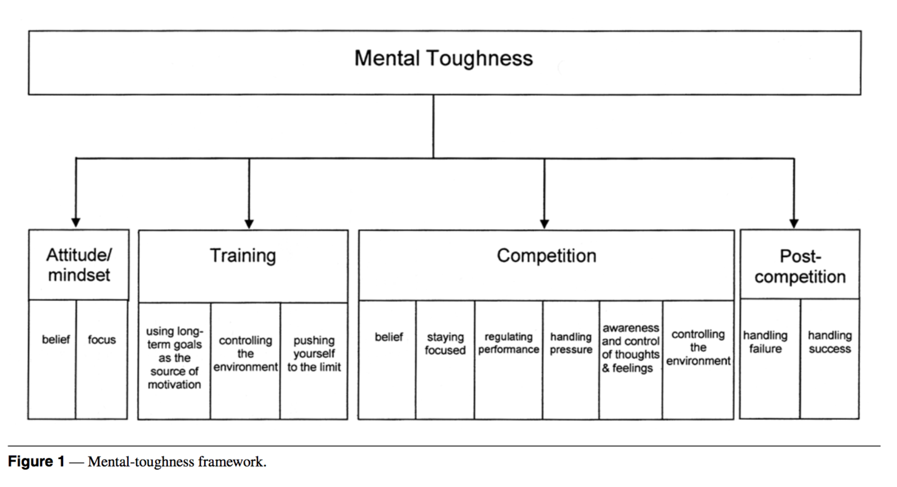
PIAT?
TONIGHT’S
FOCUS
Jones at al. (2007)
INTRO
W1R
PAR
EMAR
PIAT
DISC.
MTM

Slide 32
Process Leads Improvement
Pre-Training
Process
Training
Process
Post Training
Process
INTRO
W1R
PAR
EMAR
PIAT
DISC.
MTM

Slide 33
Checklist
Pre-training routine
Training focus
Post training routine
Better bedtime…
Goals
Effort
Readiness
Focus

Slide 34
Sport Psychology Workshop
Discipline: Cycling
Controlling the Drift Maintaining the Power
John Coumbe-Lilley, PhD, CC-AASP
Arin Weidner, Master of Science and Education Cand.
Maldron Hotel, Cardiff Lane, Dublin
Wednesday July 1, 2015

Slide 35
Agenda
Introduction
Recap Week 1&2
Mental Toughness Mindset (MTM)
Physical Activation and Readiness (PAR)
Emotional & Mental Activation and Readiness (EMAR)
Putting It Altogether (PIA)
Discussion
INTRO
W1R
PAR
EMAR
PIAT
DISC.
MTM

Slide 36
Features
Using:
Integrated mental toughness strategies
visualization strategies
Indoor deception
INTRO
W1R
PAR
EMAR
PIAT
DISC.
MTM

